Slide 1
Energy Systems

Slide 2
Housekeeping
Syllabus updated with new readings
Zoom guest lecture on 9/27
TA office hours: Monday 2-4 pm N5

Slide 3
Agenda
1:00 Energy Systems
Recap of Lecture 2
Energy systems in IAM
Q&A
2:15 Break
3:30 GCAM Tutorial
Discuss Assignment 2
Getting GCAM outputs – Model Interface
Modeling assignment 3

Slide 4
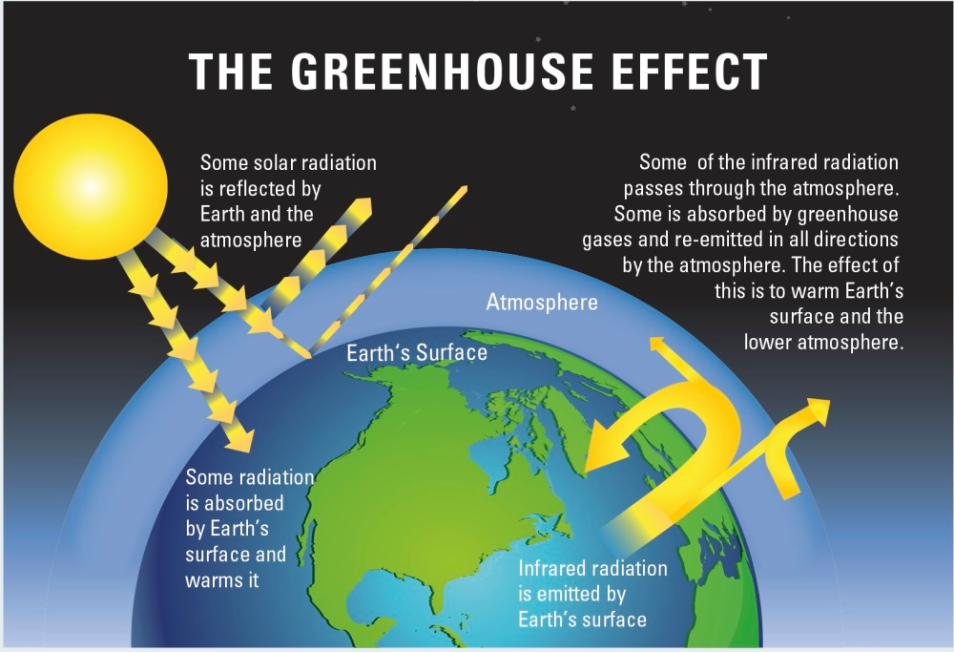
Climate Change
Average Earth temperature ~15ºC (59ºF)
Earth’s black body temperature -23°C (-9.4ºF)
Gases that change climate forcing include H₂O, CO₂, CH₄, N₂O, halons, short-lived forcers, and aerosols.
CO₂ is the most important human-generated GHG emitted
https://royalsociety.org/-/media/Royal_Society_Content/policy/projects/climate-evidence-causes/figb1-large.jpg?la=en-GB&hash=596B576CF5ADAF30D03D1AEFECF26997

Slide 5

GCAM has its roots in the same time frame
The Global Change Assessment Model (GCAM) began in 1978.
Jae Edmonds and John Reilly
Reilly was the director of the MIT IAM program until he retired in 2020.
The original science question was would fossil fuel CO2 emissions continue to rise at 4.5%/yr? (which implied that CO2 concentrations would double around the year 2000)

Slide 6
Integrated Assessment Models (IAMs) have external inputs and data, a representation of relevant systems and outputs
The Model
Exogenous Assumptions
Outputs of IAMs
Population
Economy
Agriculture & Land Use
Climate, Atmosphere, Oceans
CO₂, GHGs, aerosols, OGs
Prices, Taxes, e.g. CO₂
Labor Productivity
Commodity Prices
Technology
Economic Activity
Primary Energy Supply
Policy
Energy
Water
Carbon Cycle
Electric & Refining
Crops & Forests
Resources
Livestock
Temperature, RF
Highly non-linear, strategic models designed to consider global climate forcing and climate impacts at decadal time scales and regional disaggregation ranging from dozens to hundreds
External Data

Slide 7
Course schedule and topics
Date | Lecture Topic (w/ Guest Speaker) | Readings | What’s Due | Paper Critique
8/30 | Introduction to IAM | Reading 1 |  | -
9/6 | Foundations of IAM | Reading 2 | Assignment 1 | -
9/13 | Energy System | Reading 3 |  | -
9/20 | Land System | Reading 4 | Assignment 2 | Ahmed
9/27* | Emission System (Prof. Yang Ou) | Reading 5 | Assignment 3 | Jeongho
10/4 | Water System | Reading 6 | Assignment 4
10/11 | Food-Energy-Water Nexus | Reading 7
10/18 | Mid-Term: Project Proposal |  | Project proposal
10/25 | IAM in International Climate Policies | Reading 8
11/1 | Standardized Scenarios | Reading 9 | Assignment 5
11/8 | Multi-model Comparison | Reading 10 | Assignment 6
11/15* | IAM in National Strategies (TBD) | Reading 11 | Assignment 7
11/22 | Mitigation and other SDGs | Reading 12 | Assignment 8
11/29 | Uncertainty in IAM and Climate Change | Reading 13
12/6 | Emerging and Future Directions | Reading 14
12/13 | Final project presentation 1 |  | Presentation

Slide 8
Lecture

Slide 9

Break

Slide 10
Agenda
1:00 Energy Systems
Recap of Lecture 2
Energy systems in IAM
Q&A
2:15 Break
3:30 GCAM Tutorial
Discuss Assignment 2
Getting GCAM outputs – Model Interface
Modeling assignment 3

Slide 11
Discussion of Assignment 2

Slide 12
GCAM Tutorial

Slide 13
Assignment #3
Run a GCAM low-emission scenario
Compare GCAM energy queries under the reference and decarbonization scenarios
Plot the outcome
What fuel decreases and what fuel increases?
What sector does most of the emission reductions?
How much is demand reduction vs. fuel switching?
How much reduction happens in supply side vs. demand side?

Slide 14
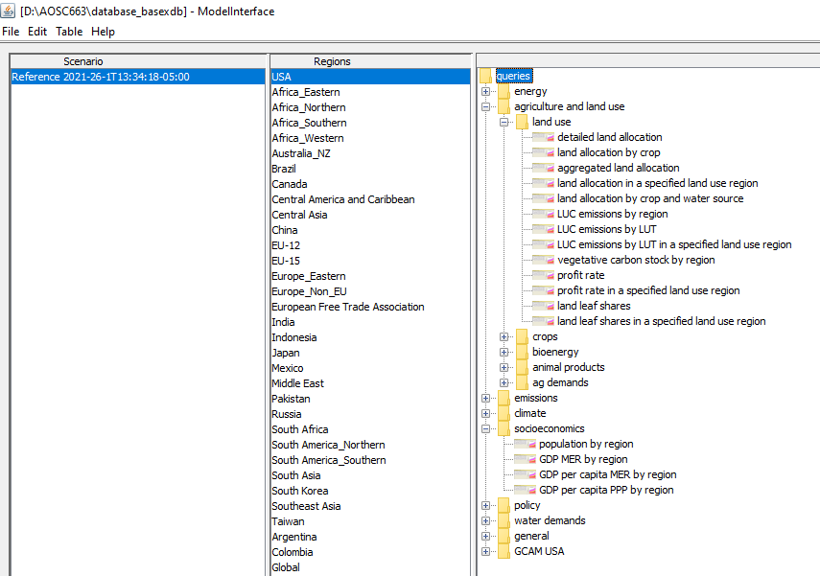
Reviewing Outputs from Assignment 2 (Reference Scenario)
Select region(s)
Select outputs in nest
Select scenario(s)
View some inputs

Slide 15
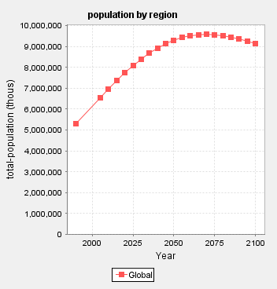
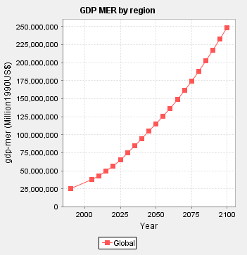
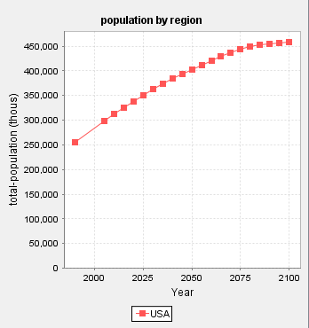
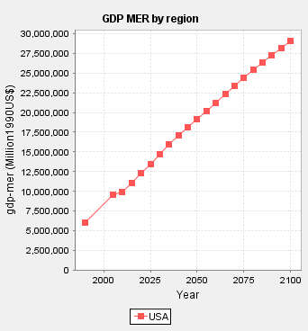
Key Model Inputs: Population and GDP
Population
GDP
These items appear in the model interface, but they are exogenous inputs to GCAM.

Slide 16
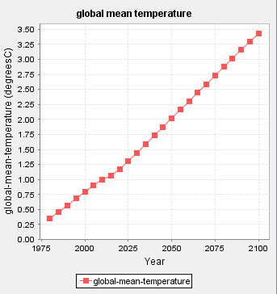
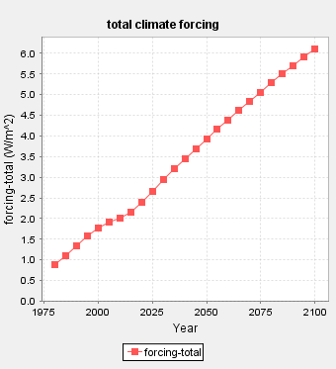
Climate
From GCAM’s simple climate model
Notes:
Here you can see we’re in an RCP6.0, which is a scenario now commonly used by IAM community.

Slide 17
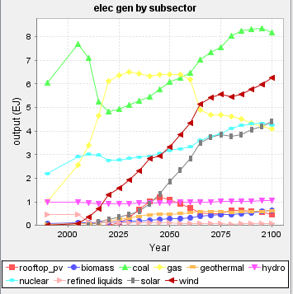
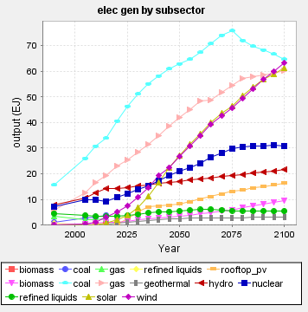
Energy (Electricity)
USA
Global

Slide 18
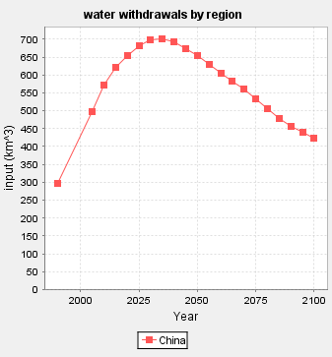
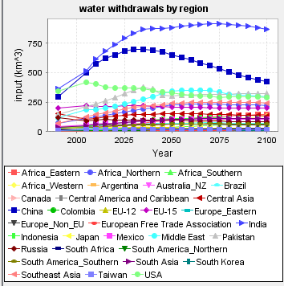
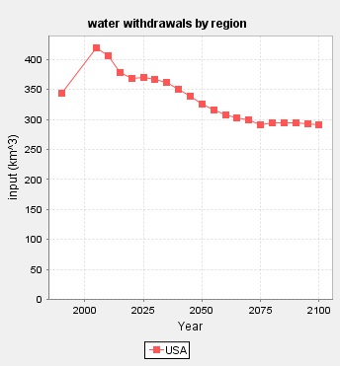
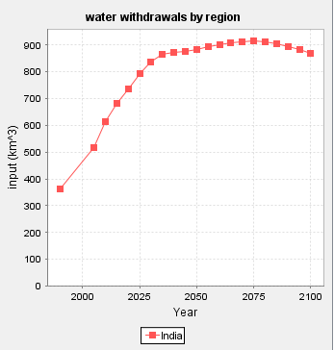
Water withdrawals by region
Global
Notes:
Top are india, US, China. We can then look at those regions individually to see they each have different patterns. Our Reference scenario has built-in efficiency improvements.

Slide 19
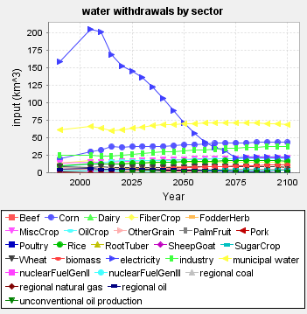
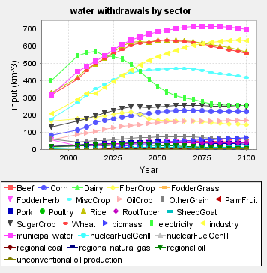
Water withdrawals by sector
Global
USA
Notes:
Together, Ag is using the most. But you’d have to post-process the data.
Built in assumptions about ag water use efficiency.
Electricity water use in US is huge right now, but it goes down over time due to changes in cooling technology.

Slide 20
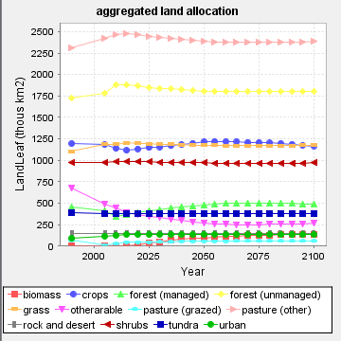
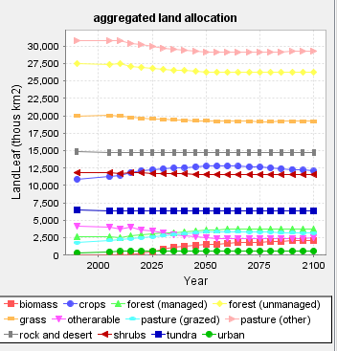
Land
Global
USA
Notes:
--there’s a tone of land, and in a reference scenario we typically do not see a lot of change in land allocation.
--Lots of pasture
--US trends similar in some ways to global, different in others

Slide 21
Useful Miscellaneous Info
All energy flows are represented in EJ/yr. Note that the “year” denominator is implicit, not written out.
Fuel carbon contents are in kgC/GJ.
Emissions units
CO2 is in MtC/yr. Multiply by 44/12 to convert to CO2
Non-CO2 gases are generally in Tg (same as Mt). Exceptions are the hi-GWP gases (e.g. HFCs, PFCs, SF6), which are in Gg (same as kt).
Dollar units
Prices of all energy and agricultural goods and services are in 1975$/GJ
GDP is in 1990$/yr
Carbon prices are in 1990$/tC. Multiply by 12/44 to convert to 1990$/tCO2.
Fuel prices in policy scenarios do not include the emissions penalties. After converting to the desired dollar year, these may be added to any technology as:
C price ($/tC) * 1t / 1000kg * Fuel C content (kgC/GJ) * (1 – sequestration fraction)

Slide 22
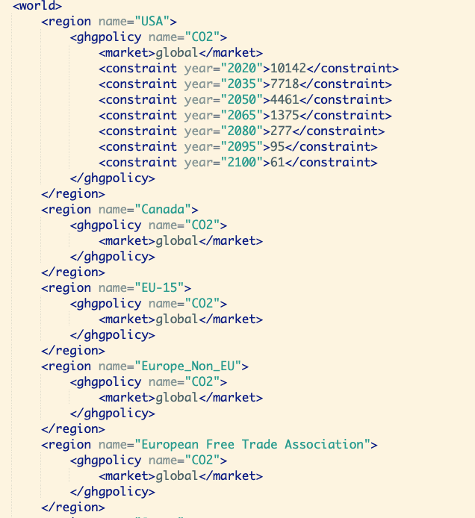
Running a policy scenario: carbon cap (constraint on annual CO2 emissions in each time period in MtC)
A global policy is specified in one region, and all others share in the market
Regional policies can be specified in individual regions
Carbon price: model solves for emissions, given a fixed price
Carbon constraint: model solves for carbon price, given emissions pathway.
Economic equilibrium is not influenced by which factor was specified

Slide 23
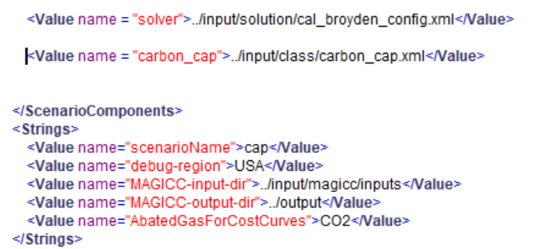
Configuration file: carbon cap
Add additional XML (“add-on”) files at the end of
the existing <ScenarioComponents>
Change the “scenarioName”

Slide 24
Assignment #3
Run a GCAM low-emission scenario
Compare GCAM energy queries under the reference and decarbonization scenarios
Plot the outcome
What fuel decreases and what fuel increases?
What sector does most of the emission reductions?
How much is demand reduction vs. fuel switching?
How much reduction happens in supply side vs. demand side?

Slide 25
Q&A

Slide 26
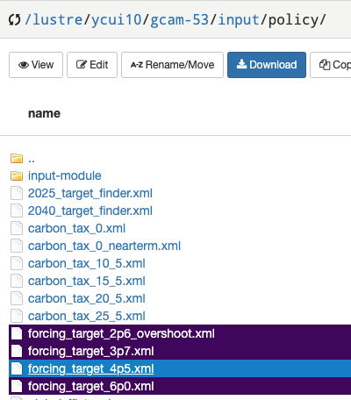
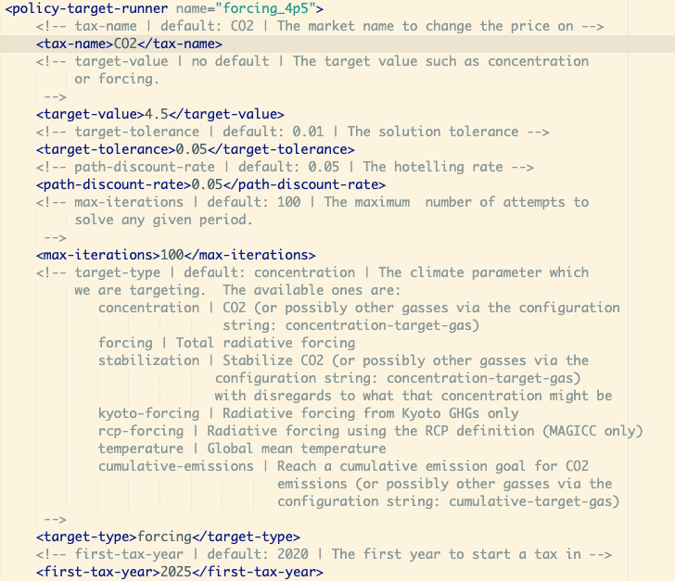
(advanced) Running a policy scenario: target finder
Target
Different types of targets
First year to start the tax

Slide 27
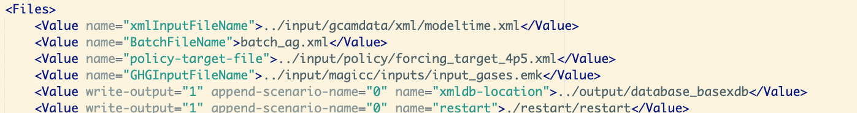
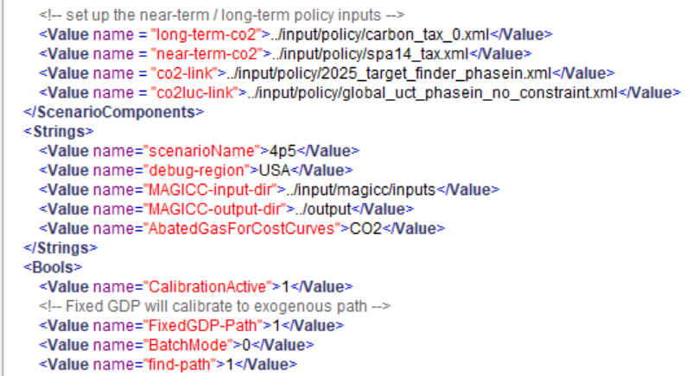
Configuration file: target finder
Defines a policy target to be met
Near-Term adjustments
Change the “scenarioName”
Turn on find path

Slide 28
Reading Reflections
What are the key components of the energy system?
What are the key drivers of energy system transformations?
What do you think are some examples of the challenges in modeling energy system transition?

